Slide 1
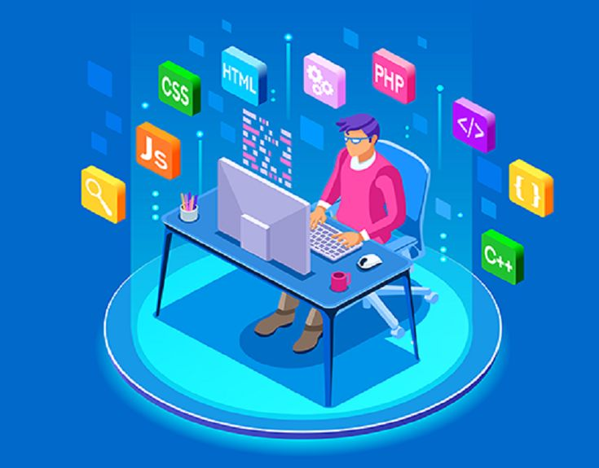
FULL STACK DEVLOPMENT

Slide 2

FRONT-END DEVELOPER
Front end developers also have to make sure the website looks good on all devices (phones, tablets, and computer screens).
FRAMEWORK & LANGUAGES
REACTJS
ANGULER
BOOTSTRAP
VIEW JS
JQUERY
HTML CSS
JAVASCRIPT

Slide 3
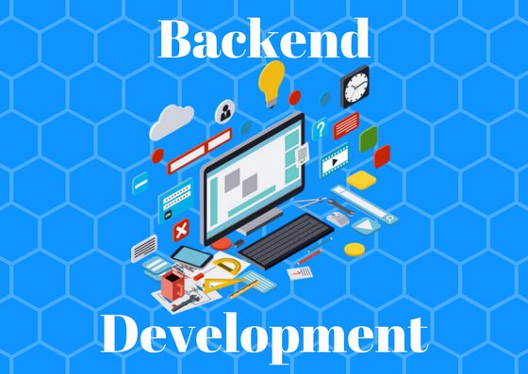

BACK-END DEVLOPER
Web development activities that are done at the back end of programs are referred to as back end development. Back-end development covers server-side web application logic and integration and activities, like writing APIs, creating libraries, and working with system components instead of frontend development,
which focuses on customer-facing services and programs. Backend developers build code that allows a database and an application to communicate with one another.
BACK-END LANGUAGE
JAVA
PYTHON
NODE JS
PHP

Slide 4
ABOUT FULL-STACK DEVLOPMENT
A full-stack developer is a developer or engineer who can build both the front end and the back end of a website. The front end (the parts of a website a user sees and interacts with) and the back end (the behind-the-scenes data storage and processing) require different skill sets.

Slide 5


